Slide 1
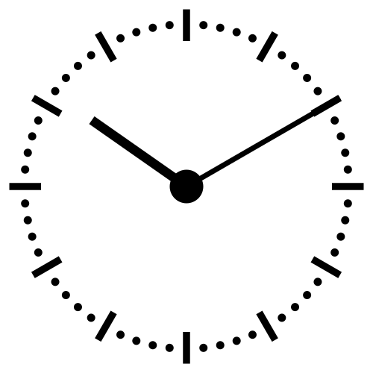
The Fourth Hour!
Welcome to…

Slide 2
Introduction
Welcome to the Fourth Hour!
Name
Professor
A fun fact about you

Slide 3
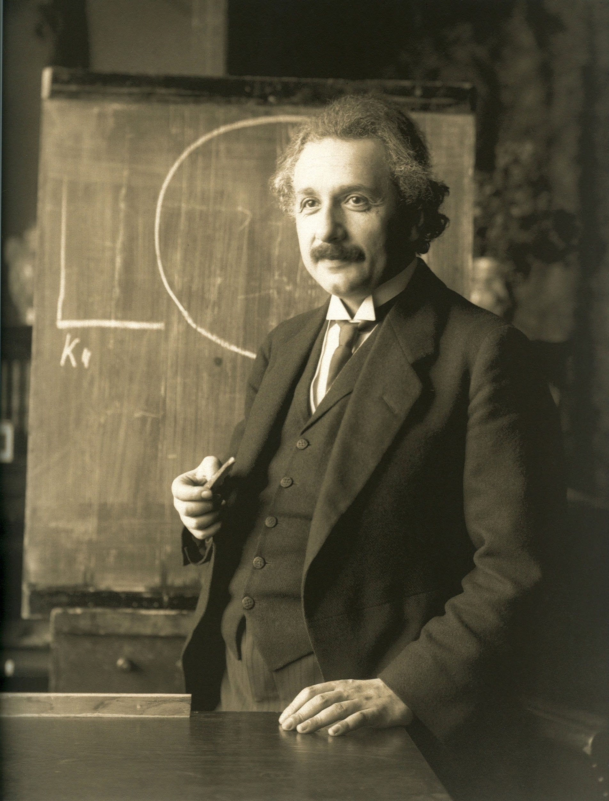
“Anyone who has never made a mistake has never tried anything new.”

Slide 4
Order of Operations in CS
P
E
M D
A S
=
Notes:
In CS we use the acronym PEMDAS to remember the order of operations. But there is a catch we are going to for the purpose of this activity add an = sign at the end

Slide 5
Order of Operations in CS
Parenthesis ()
E
M D
A S
=
Notes:
In CS we use the acronym PEMDAS to remember the order of operations. But there is a catch we are going to for the purpose of this activity add an = sign at the end

Slide 6
Order of Operations in CS
Parenthesis ()
Exponents x ** 2
M D
A S
=
Notes:
In CS we use the acronym PEMDAS to remember the order of operations. But there is a catch we are going to for the purpose of this activity add an = sign at the end

Slide 7
Order of Operations in CS
Parenthesis ()
Exponents x ** 2
Multiplication * Division \
A S
=
Notes:
In CS we use the acronym PEMDAS to remember the order of operations. But there is a catch we are going to for the purpose of this activity add an = sign at the end

Slide 8
Order of Operations in CS
Parenthesis ()
Exponents x ** 2
Multiplication * Division \
Addition + Subtraction -
=
So what does the = stand for?
Notes:
In CS we use the acronym PEMDAS to remember the order of operations. But there is a catch we are going to for the purpose of this activity add an = sign at the end

Slide 9
Assignment
x = 5
Read as: x is assigned the value 5

Slide 10
Review
Login to Socrative at https://b.socrative.com/login/student/
Use code 4thHour149

Slide 11
Question 1
What is the value of x?
x = (6 / 3) ** 2 + 1 * 2
10.0
16.0
6.0
ERROR

Slide 12
Question 1
What is the value of x?
x = (6 / 3) ** 2 + 1 * 2
10.0
16.0
6.0
ERROR

Slide 13
What is Mod?
Mod is often used to find the REMAINDER
For example, when evaluating the arithmetic expression 17 / 3 the result is

Slide 14
What is Mod?
Mod is often used to find the REMAINDER
For example, when evaluating the arithmetic expression 13 / 2 the result is
6.5

Slide 15
What is Mod?
Mod is often used to find the REMAINDER
For example, when evaluating the arithmetic expression 13 / 2 the result is
6.5
But what happens to the remainder value?

Slide 16
What is Mod?
Mod is often used to find the REMAINDER
For example, when evaluating the arithmetic expression 13 / 2 the result is
6.5
But what happens to the remainder value?
We can use mod to get the remainder of the arithmetic expression above
What is the result of 13 % 2

Slide 17
What is Mod?
Mod is often used to find the REMAINDER
For example, when evaluating the arithmetic expression 13 / 2 the result is
6.5
But what happens to the remainder value?
We can use mod to get the remainder of the arithmetic expression above
What is the result of 13 % 2
1

Slide 18
Question 2 - PI
Assume that x refers to a three-digit integer. Which of the
following evaluates to the middle digit of x? (For example, if a
referred to value 456, we want an expression with value 5.)
(x // 10) % 10
(x % 100) // 10
(x % 10) // 10
More than one of the above
None of the above
Notes:
a and b are correct

Slide 19
Question 2 - PI
Assume that x refers to a three-digit integer. Which of the
following evaluates to the middle digit of x? (For example, if a
referred to value 456, we want an expression with value 5.)
(x // 10) % 10 → 5
(x % 100) // 10 → 5
(x % 10) // 10 → 0
More than one of the above
None of the above
Notes:
a and b are correct

Slide 20
Printing
If we want to do a simple print statement we can do:
print(“Hello world!”)
Hello world!
But what if we want to print two Strings what would we do?

Slide 21
Printing
If we want to do a simple print statement we can do:
print(“Hello world!”)
Hello world!
But what if we want to print two Strings what would we do?
print(“Hello” + “ world!”)
Hello world!

Slide 22
Printing
What if we want to print a String and a variable?
word = “Hello”

Slide 23
Printing
What if we want to print a String and a variable?
word = “Hello”
print(a + “world!”)
Helloworld!
or
print(a, “world!”)
Hello world!
Note that the , adds a space while the + does not.
Notes:
some ppl dont know the comma vs plus so i figure we do this quick

Slide 24
String From User Input
How do we get a String from the user?

Slide 25
String From User Input
How do we get a String from the user?
name = input(“What is your name?”)

Slide 26
String From User Input
How do we get a String from the user?
name = input(“What is your name?”)
print(“Name:”, name)
What is your name? Reese
Name: Reese
We now have the String “Reese” stored in the variable name

Slide 27
Manipulating User Input
Let’s continue with name = “Reece”
How would we get just the first letter?

Slide 28
Manipulating User Input
Let’s continue with name = “Reece”
How would we get just the first letter?
print(name[0])
What about just the last letter?

Slide 29
Manipulating User Input
Let’s continue with name = “Reece”
How would we get just the first letter?
print(name[0])
What about just the last letter?
print(name[-1]) or print(name[len(name) - 1])
In Python we can use negative indices to go backwards through a String

Slide 30
Question 3
What does the following code print?
phrase = “Rock and Roll!”
print(phrase[len(phrase)])
‘R’
‘!’
‘l’
ERROR

Slide 31
Question 3
What does the following code print?
phrase = “Rock and Roll!”
print(phrase[len(phrase)])
‘R’
‘!’
‘l’
ERROR

Slide 32
Manipulating User Input
Each letter of the String “Reese” can be represented in more than one way.
0
1
2
3
4
Reese
-5
-4
-3
-2
-1
Notice how the first letter has an index of 0 and the last one is the length of the String - 1
Notes:
name[5] AND name[-6] generate index out of range

Slide 33
Lists
A comma separated list of items enclosed by square brackets is a list
Lists can store any type in Python for example:
nums = [1, 2, 3, 4, 5, 6, 7]
nums2 = [1, 2, “three”, 4, 5, “six”, 7]
classes = [“CS 149”, “CS 101”, “HTH 100”, “MATH 220”]
double_list = [1, 2, 3, [4 , 5]]

Slide 34
List Operations
lst1 = [1, 2, 3] lst2 = [4, 5, 6]
lst1 + lst2 = ?

Slide 35
List Operations
lst1 = [1, 2, 3] lst2 = [4, 5, 6]
lst1 + lst2 = [1, 2, 3, 4, 5, 6]
len(lst1) = ?

Slide 36
List Operations
lst1 = [1, 2, 3] lst2 = [4, 5, 6]
lst1 + lst2 = [1, 2, 3, 4, 5, 6]
len(lst1) = 3
min(lst2) = ?

Slide 37
List Operations
lst1 = [1, 2, 3] lst2 = [4, 5, 6]
lst1 + lst2 = [1, 2, 3, 4, 5, 6]
len(lst1) = 3
min(lst2) = 4
sum(lst1 + lst2) = ?

Slide 38
List Operations
lst1 = [1, 2, 3] lst2 = [4, 5, 6]
lst1 + lst2 = [1, 2, 3, 4, 5, 6]
len(lst1) = 3
min(lst2) = 4
sum(lst1 + lst2) = 21
lst1*3 = ?

Slide 39
List Operations
lst1 = [1, 2, 3] lst2 = [4, 5, 6]
lst1 + lst2 = [1, 2, 3, 4, 5, 6]
len(lst1) = 3
min(lst2) = 4
sum(lst1 + lst2) = 21
lst1*3 = [1, 2, 3, 1, 2, 3, 1, 2, 3]

Slide 40
Question 4
What does the following code print?
q2 = [5]
print(q2*3)
[15]
[5, 5, 5]
15
ERROR

Slide 41
Question 4
What does the following code print?
q2 = [5]
print(q2*3)
[15]
[5, 5, 5]
15
ERROR

Slide 42
Tuples
Tuples and lists are the same except tuples are immutable while lists are mutable.
What does this mean?
Mutable means that a variable can be changed or modified.
Immutable means that a variable cannot be changed

Slide 43
Tuples
Mutable means that a variable can be changed or modified.
Immutable means that a variable cannot be changed
For example:
myTuple = ("apple", "banana", "cherry")
myTuple[0] = "orange"
Gives us an error when we run:
TypeError: 'tuple' object does not support item assignment

Slide 44
Dictionary
Dictionaries are a list of keys and values for example:
dict = {‘name’: 'Reese', ‘age’: '22', ‘major’: ‘CS’}
Notice how the dictionary is declared by listing key: value pairs
What would we do if we wanted to add a Hometown of Richmond to the dictionary above?

Slide 45
Dictionary
Dictionaries are a list of keys and values for example:
dict = {‘name’: 'Reese', ‘age’: '22', ‘major’: ‘CS’}
Notice how the dictionary is declared by listing key: value pairs
What would we do if we wanted to add a Hometown of Richmond to the dictionary above?
dict[‘Hometown’] = Richmond

Slide 46
Dictionary
Dictionaries do not use indices, instead just use the key to get and remove
dict = {'name': 'Reese', 'age': 22, 'major': 'CS'}
print(dict.get(‘name’))
Reese
dict.pop(‘name’)
print(dict)
{'age': 22, 'major': 'CS'}

Slide 47
Set
Essentially a list, but it can not contain duplicates.
For example:
nums = {1, 2, 3}
nums.add(4) → ?

Slide 48
Set
Essentially a list, but it can not contain duplicates.
For example:
nums = {1, 2, 3}
nums.add(4) → {1, 2, 3, 4}
nums.add(4) → ?

Slide 49
Set
Essentially a list, but it can not contain duplicates.
For example:
nums = {1, 2, 3}
nums.add(4) → {1, 2, 3, 4}
nums.add(4) → {1, 2, 3, 4}
nums.remove(4) → ?

Slide 50
Set
Essentially a list, but it can not contain duplicates.
For example:
nums = {1, 2, 3}
nums.add(4) → {1, 2, 3, 4}
nums.add(4) → {1, 2, 3, 4}
nums.remove(4) → {1, 2, 3}

Slide 51
Question 5
What does the following code print?
words = {“apple”, “banana”, “carrot”}
words.add(“banana”)
words.add(1)
{“apple”, “banana”, “carrot”}
{“apple”, “banana”, “carrot”, 1}
{“apple”, “banana”, “carrot”, banana, 1}
ERROR
Notes:
Make sure they determine type first {} means set

Slide 52
Question 5
What does the following code print?
words = {“apple”, “banana”, “carrot”}
words.add(“banana”)
words.add(1)
{“apple”, “banana”, “carrot”}
{“apple”, “banana”, “carrot”, 1}
{“apple”, “banana”, “carrot”, banana, 1}
ERROR
Notes:
Make sure they determine type first {} means set

Slide 53
Functions
Functions can be used to avoid code duplication
Why does this matter?

Slide 54
Functions
Functions can be used to avoid code duplication
Why does this matter?
Avoiding code duplication makes code easier to debug and maintain.
It can also make code easier to read and understand.
Notes:
explain stuff like If you fix a bug in a function it immediately gets fixed everywhere the function is called etc etc

Slide 55
Defining and Using Functions
The part of the program that creates a function is called the function definition
A function definition looks like this:
def function(<parameters>):
<body>
When we go to use a function it can be called or invoked by typing:
function(<arguments>)
Notes:
make sure they know <body> and <parameter> are supposed to be substituted

Slide 56
Question 6
For example if we have the following function:
def myFunc(phrase):
print(“Then he said”, phrase)
How would we call this function?
myFunc(“let’s go”)
myFunc
myFunc(phrase)
We can’t

Slide 57
Question 6
For example if we have the following function:
def myFunc(phrase):
print(“Then he said”, phrase)
How would we call this function?
myFunc(“let’s go”)
myFunc
myFunc(phrase)
We can’t

Slide 58
Defining and Using Functions
For example if we have the following function:
def myFunc(phrase):
print(“Then he said”, phrase)
How would we call this function?
myFunc(“let’s go”)
Then he said let’s go

Slide 59
Parameters and Arguments
Parameters and arguments are a way to move data between functions.
The difference between the two is that parameters are given the values of the arguments and then the statements in the body of the function are executed.
def function(<parameters>):
<body>
While arguments are used when the function is called/invoked.
function(<arguments>)
Notes:
Explain this in plain english as this is a little wordy. “So as you can see in the function definition…. and when the function is invoked…”

Slide 60
Question 7 - PI
def myFunc(phrase):
print(phrase)
def main():
phrase = “Let’s go!”
myFunc(“Goodbye”)
What prints when main() is run?
Let’s go!
Goodbye
Let’s go!Goodbye
ERROR
Notes:
explain scope

Slide 61
Question 7 - PI
def myFunc(phrase):
print(phrase)
def main():
phrase = “Let’s go!”
myFunc(“Goodbye”)
What prints when main() is run?
Let’s go!
Goodbye
Let’s go!Goodbye
ERROR
Notes:
explain scope

Slide 62
Parameters and Arguments
Like other variables used in the function, parameters are only used inside the body of the function.
Even if there are variables with the same name in the program, the function ignores these and only uses the variables passed or declared in it.
Notes:
explain this I am hoping it wont be confusing given the previously asked question

Slide 63
Return Statements
Now that we know how to pass data into a function, how do we get it out?
We use return statements!
Once python encounters “return” it exits the function and passes the data given
The code will then continue to execute as normal

Slide 64
Return Statements
Let’s modify the myFunc function to return instead of print its value.
def myFunc(phrase):
print(“Then he said”, phrase)
Notes:
Walk them through this

Slide 65
Return Statements
Let’s modify the myFunc function to return instead of print its value.
def myFunc(phrase):
return “Then he said “ + phrase
Notes:
Walk them through this explain why we must use a + here not a , (comma indicates set we want a string)

Slide 66
Return Statements
Let’s modify the myFunc function to return instead of print its value.
def myFunc(phrase):
return “Then he said “ + phrase
To get the string out of this function we must
phrase = myFunc(“let’s go”)
print(phrase)
Then he said let’s go
Notes:
Walk them through this

Slide 67
Practice *if time permits
Write a function called flipper that takes a list as a parameter, flips the first and last elements, then prints the result
Notes:
Do on board but
def flipper(lst):
first = lst[0]
last = lst[-1]
lst[0] = last
lst[-1] = first
print(lst)

Slide 68
Practice *if time permits
Write a function called doubler that takes a number as a parameter, multiplies it by 2, and prints the result.

Slide 69
Practice *if time permits
Consider this code:
import math
print("The area of circle with radius 5 is ", math.pi * 5 ** 2)
print("The area of circle with radius 8 is ", math.pi * 8 ** 2)
print("The area of circle with radius 2 is ", math.pi * 2 ** 2)
Eliminate the redundancy in this code by defining an area function and calling it three times.
Notes:
Just do this on the board

Slide 70

Questions?

